Slide 1
Department of Veteran Affairs’ Pharmaceutical Pricing
The D.E.A - Group 8
Alex May, Deep Adusumalli, Emily Painter

Slide 2
Introduction / Dataset
20,238 observations over 17 variables, each observation catalogs a unique drug pricing negotiation between the VA and a commercial vendor.
Additionally, we cross referenced the 2021 pharmaceutical data with previous data from the VA. Our supplementary data contains 17,312 observations over 16 variables from 2016.
Given increasing discussion of inflation of drug prices in the US, we sought to determine if examining the VA’s pharmaceutical contracts could provide insight into the pharmaceutical market at large, with specific focus on the relationships among classification, price typing, and vendors.

Slide 3
Terms
Price Types:
FSS : Federal Supply Schedule. The broadest pricing, available to all direct federal purchasers.
Big 4: Subset of the FSS. Products may not be sold over the Federal Ceiling Price (FCP) to the Department of Defense (DoD), Public Health Services (PHS), the Coast Guard, and the VA. “Big 4” as a price type denotes that the typical FSS price was above the FCP, and the VA thus purchased the given product at the reduced (FCP) Big 4 price. Since our data is focused on the VA, we can conclude that any FSS purchase was, in fact, priced at the FCP or below and there was no special Big 4 reduced cost.
VA National Contract: Reduced pricing specifically negotiated between the VA and the vendor directly, often conditional upon the VA purchasing from the vendor in the future.
Notes:
Verbally note what the FCP is in slightly more depth than just its name-- its Minimum 24% less than what’s charged to non-federal buyers

Slide 4
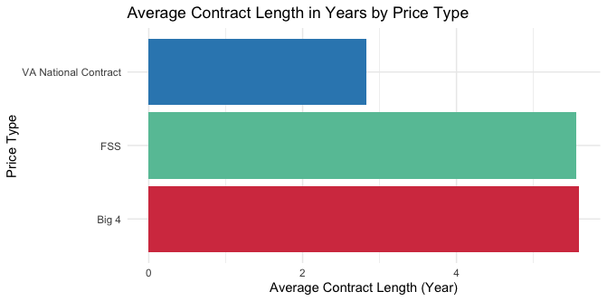
How Does Price Type Affect Contract Length?
Overall average contract length is 5.42 years
VA contract length difference could suggest that, while the VA is willing to commit to vendors for the short time benefit of reduced pricing, they’re not willing to commit to the standard contract length
Notes:
Verbal note: Similarities between FSS and Big 4 and why we expect to see that since they’re basically the same thing

Slide 5
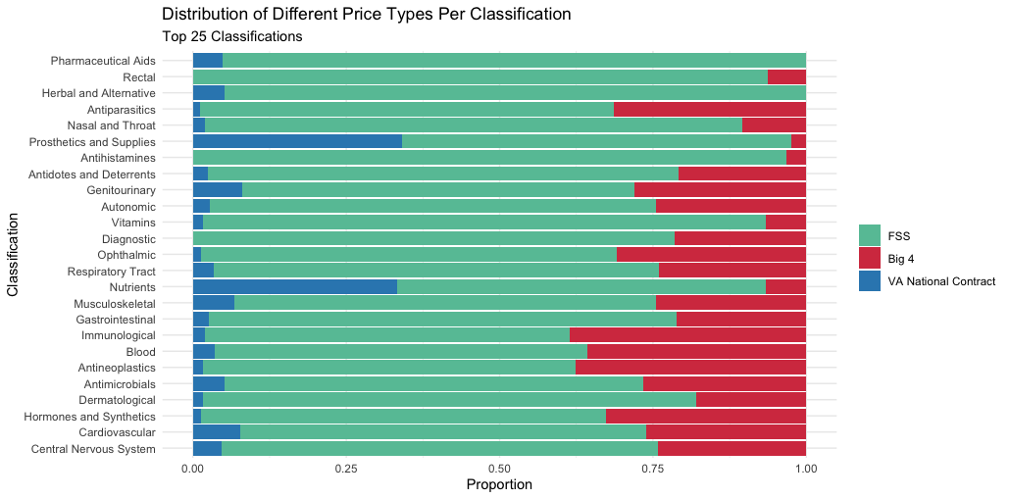
How Do Different Classifications Vary in Price Type?
FSS and Big 4 represent the most data, as expected
VA National Contract disproportionately represented in Nutrients and Prosthetics and Supplies, most notably.
Notes:
Verbal notes: Irrigation and dialysis often not a prescribed medication and overrepresenting VA, additional points towards conception that the VA largely negotiates specialized contracts for those products that aren’t provided through the FSS all-- mostly uncovered products. Tie it all back to previous two charts
Note to be cautious of justified bar charts such as these because, while they help us better visualize the trends within each category, for example, irrigation and dialysis only has 26 observations. Point to prosthetics and supplies and nutrients, both of which have a few hundred observations, as a better representation of the VA + uncovered trend we’re going for.
Point out how vast majority of classifications clearly fall into big 4 or fss and how this is to be expected given the VA is the most specialized and exclusive type of contract.

Slide 6
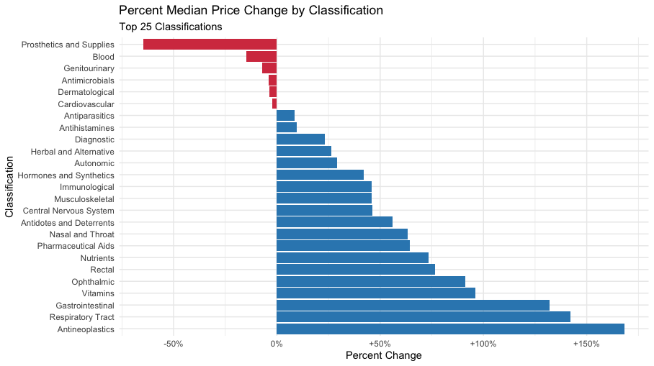
How Does Price Change Based on Classification ?
Notes:
Verbal notes: Explain how this chart was calculated: that the aggregate median price per classification in the 2016 data was compared against the median price per classification in the 2021 data
Immediately point out how the most extreme changes in price are deceptive as they are extremely underrepresented, but point to the runnerups, which are significantly more interesting
Prosthetics as really the only one to see a significant decrease, and how that is one of the classifications we’ve previously identified as being a higher proportion VA than most
Antineoplastics are drugs used to treat cancer… when we as a society discuss drug prices and medical care becoming more expensive, we’re usually looking through the lens of the most extreme and expensive cases… so when we see that antineoplastic median prices have increased by over 150%, that’s notable and could explain a lot to the public perception of drug prices bubbling in recent years
Respiratory tract also sees significant increase, possible in some way related to COVID-19.
Cardiovascular, an extremely consistent presence as one of the most prominent causes of death and illness, the most stable of all

Slide 7
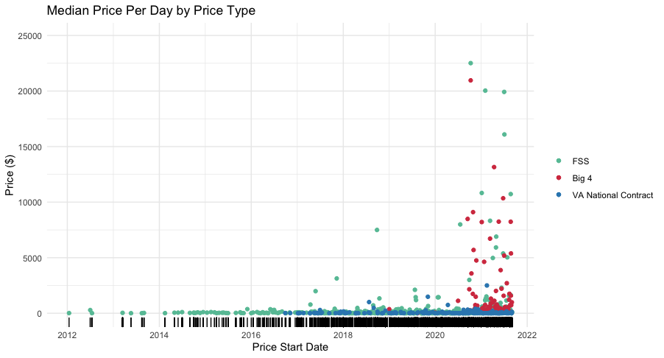
How Does Median Price per Price Type Change Over Time?
Vertical spread of FSS and Big 4 prices support conception that VA prices are consistently lower than even the reduced prices that most federal buyers receive.
VA being focused exclusively on the later dates aligns with reduced contract length typical of a VA price-typed product.
Notes:
Point out that this is a weaker relationship than I think most of us would initially suspect when plotting price vs date. Certainly there is a relationship, but the perceived relationship could also simply be a result of greater numbers of observations on later days

Slide 8
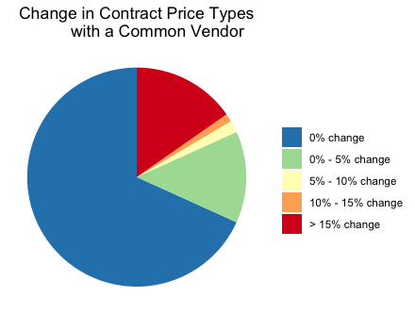
Do Vendors that have Previously Worked with the VA Renegotiate Price Typing?
68% of the 170 vendors common to both the 2016 and 2021 data maintained the exact same proportion of price type contracts.
Suggests that renegotiations or reclassifications in price type are infrequent and that terms of contracts remain relatively consistent given a consistent vendor.
If we continue with our model in that, at least to some extent, price typing is characterized by classification, it logically follows that contract price types would remain relatively consistent with a consistent vendor. Vendors aren’t going to change the types of products they’re selling, so why would price type change?
Notes:
Describe how we found this percent change

Slide 9
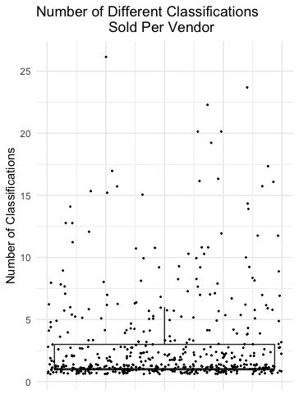
How Many Classifications Does Each Vendor Sell?
Clustering towards the lower end of the distribution suggests that the vast majority of vendors working with the VA are small -- only producing 1-3 different classification products.
Outliers-- vendors who sell many different types of products-- are largely big name companies with many resources and divisions: Golden State Medical, Major Pharmaceuticals, Pfizer, et cetera.
Notes:
Verbal notes: Over half of all vendors sell only 1 classification (median is 1). 75% sell 3 or fewer

Slide 10
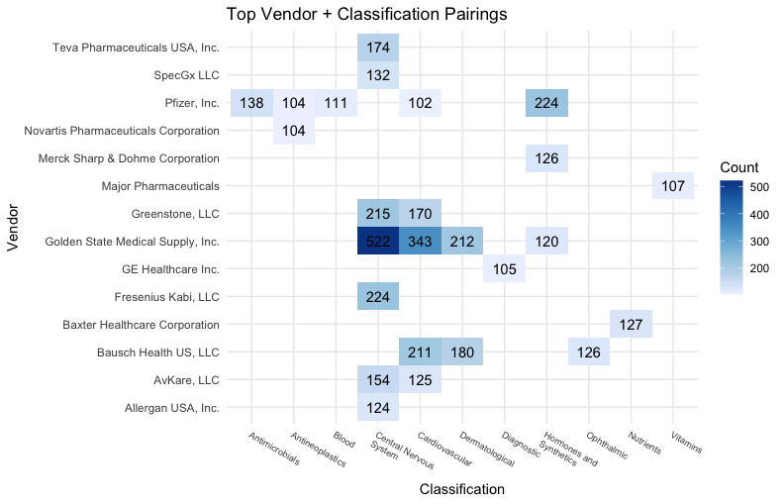
A Further Look at Some of the Biggest Vendors
This heat map, which only shows the top 25 vendor + classification pairings, represents 4,217 observations, over ⅕ of all the data.
These 14 vendors, out of 501 total, represent a minimum of 20% of the data, suggesting that despite the vast majority of vendors being small and specialized, the few big vendors overwhelmingly influence the shape and trends in the data.

Slide 11
Future Work
Use the datasets between 2017-2019 so we can plot year over year changes.
Analyze the 2020-2021 time frame specifically to see if there were any significant changes in specific classifications of contracts that were signed in 2020/2021 because of COVID-19.
Compare federal price fluctuations with consumer price fluctuations.

